Slide 1
IITM PARADOX’22 HACK-O-PITCH IITM Optimist - capturing drops of life
Team: Optimus2030
Members: Brahmasoor Anirudhan
Deepthi Luke
Jithin George
Sampoorna Varshinii M.K.S

Slide 2
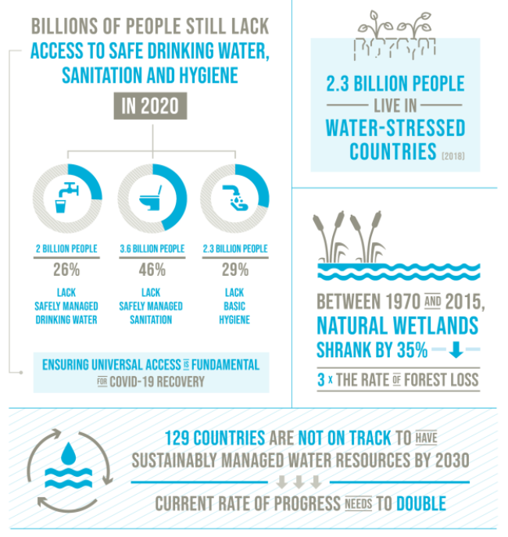
Issue: Water Scarcity / Unavailability

Slide 3
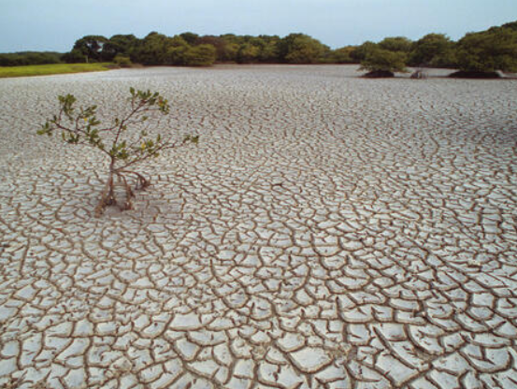
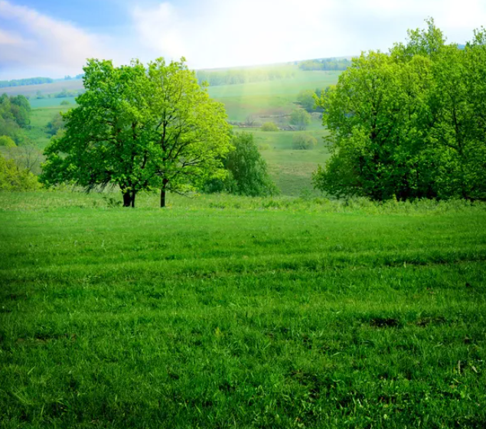
Select your future? Which one do you prefer?

Slide 4

Goal: To ensure availability and sustainable management of water

Slide 5
Optimist - capturing drops of life
Rain Water – The unused potential
1. Reduce the usage of treated water.
2. Rain water harvesting improve water quality
3. Better yield from crops
4. Revive Aqua life
5. Better availability of water during summer
6. Reduce pollution of freshwater

Slide 6
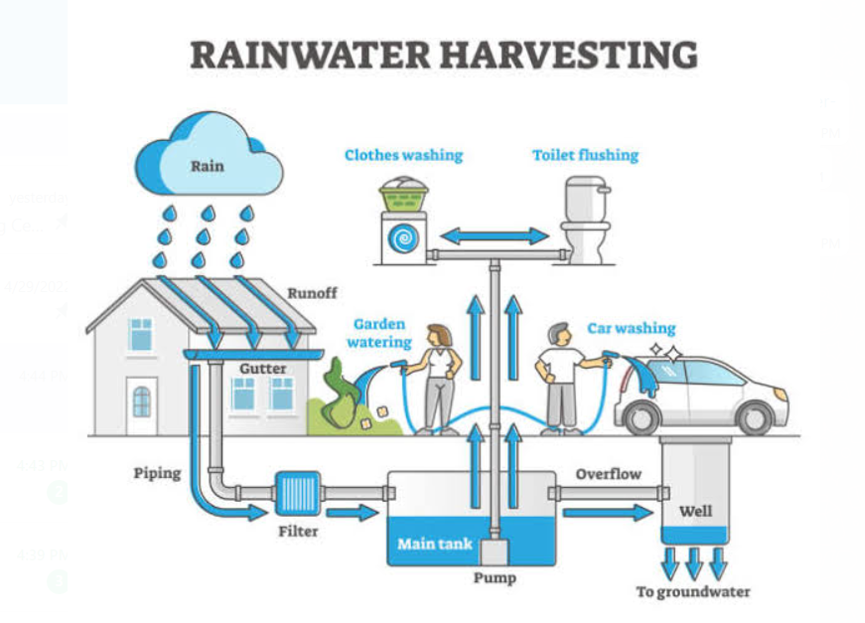
Solution: Smart Water Harvesting

Slide 7
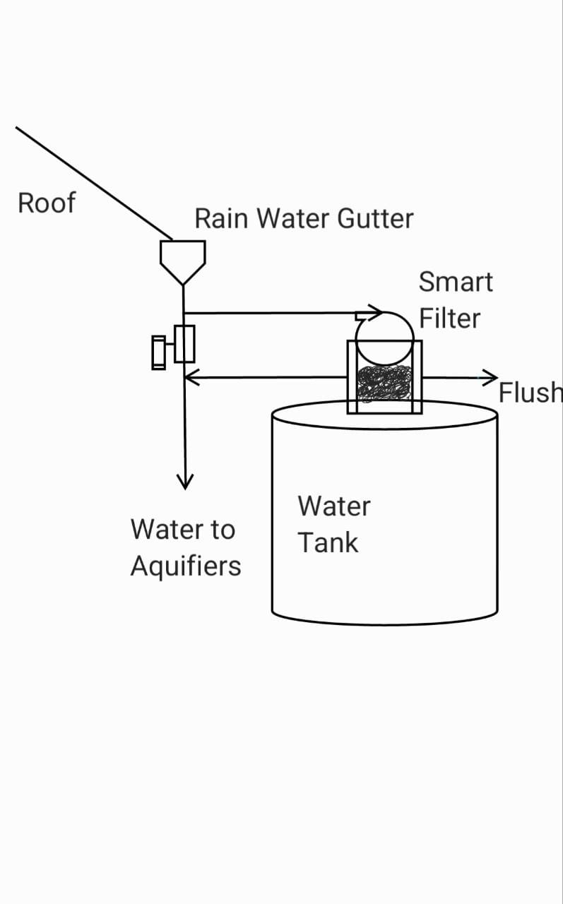
System Flow Diagram
Features
IoT powered monitoring
Self cleaning filter
Auto regenerating media
Potable water discharge
UV Disinfection
Water saving analytics

Slide 8
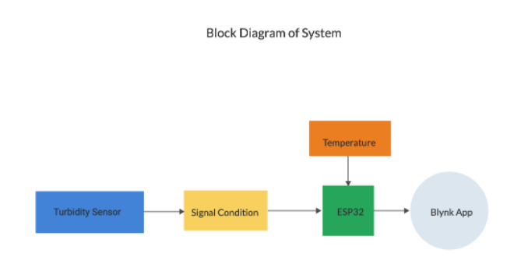
System Block Diagram

Slide 9
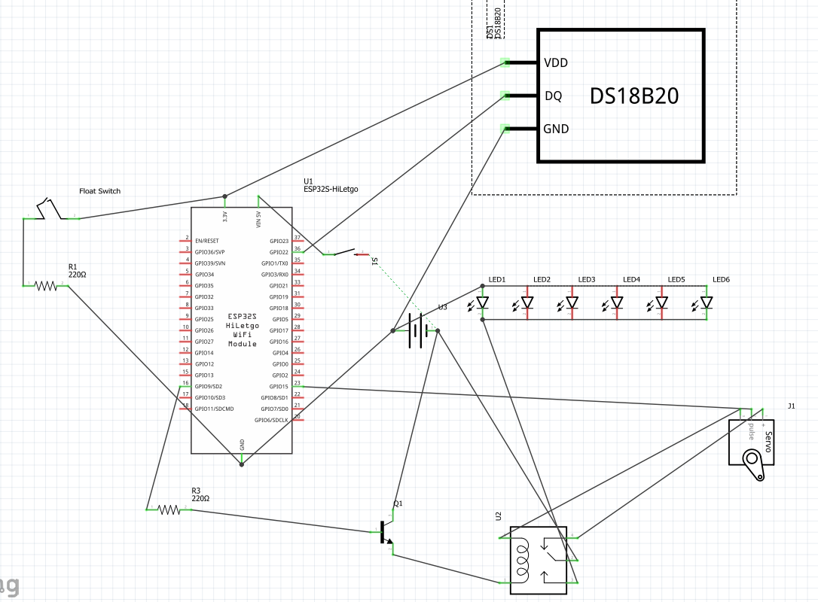
IoT Powered purified water harvesting
Components
ESP32
Turbidity sensor
6W UV LED disinfection
Solar Powered
Weather based control

Slide 10
Q & A

Slide 11
Thank You

